Slide 1
Virtual Machines
John York
Shenandoah Valley Governor’s School
Fall 2021

Slide 2
Before Virtual Machines (VMs) became widespread…
Each major function (email, web, file server, database, etc.) had its own separate server or servers, with their own hardware
It was unwise to put too many functions on one hardware server; if it crashed, the organization suffered until the server was restored
Restoring a crashed server could take several hours, or more
Each server was an island that could not share disk space, RAM, or CPU time with other servers
Running a server at high utilization (>75%) of disk, RAM, or CPU was risky
Therefore, unused capacity was wasted

Slide 3
Before VMs and SANs*—couldn’t share RAM, Disk Space or CPU time
Mail Server
Print Server
Directory Controller
File Server
Unused RAM
Unused RAM
Unused RAM
Unused RAM
RAM
RAM
RAM
RAM
Unused Disk
Unused Disk
Unused Disk
Unused Disk
Disk Space
Disk Space
Disk Space
Disk Space
*SAN is Storage Area Network, allowed sharing disk space

Slide 4
VM Advantages
Build “farms” of host servers for VMs
If one host fails, move VMs to a new host quickly
VMs are just files, so it is easy to store backup copies, snapshots, and clone new VMs
If a VM is corrupted, delete it and replace it with a backup copy
Time to restore damaged host or VM reduced to minutes
Much more efficient use of disk space, CPUs, and RAM
No more islands of unusable capacity
VMs paved the way for Cloud Services
Cloud provider has huge installations of host servers, all running many VMs

Slide 5
Sharing Resources with VMs and SANs
Host 1
Host 2
Host 3
VM 4
VM 3
VM 7
Storage Area Network (SAN) shared disk space for all hosts
VM 2
VM 6
VM 1
VM 5

Slide 6
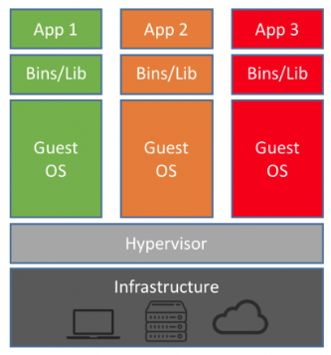
VM Architecture (greatly simplified)
Infrastructure is the hardware of the host server
Hypervisor controls the VMs and their access to resources (disk, CPU, RAM)
Driver software in the hypervisor makes the Guest OSs think they are connected directly to hardware
Each VM (green, orange, red) has its own OS installation
Contact between VMs is blocked, unless the hypervisor specifically allows it
https://blog.netapp.com/blogs/containers-vs-vms/

Slide 7
VM Advantages for our class
We can experiment with new OSs by building VMs; delete them when we are done
With enough disk, RAM, and CPU, we can build networks of VMs
Practice with servers and workstations together
Practice with scanning and attack tools; everything stays within our host computer and does not affect the network
Safe environment (mostly) to examine malware
(mostly, because vulnerabilities (rare) may allow malware to escape from the VM and attack the host or other VMs)
Try other people’s VMs, like Cyber Patriot VMs

Slide 8
Major VM Hypervisors
VMware https://www.vmware.com/
Workstation, Workstation Player, and Fusion (Mac) for our use
ESXi and vSphere for server establishments
CyberPatriots uses VMware
Oracle VirtualBox https://www.virtualbox.org/
Microsoft Hyper-V included in Windows 10 Pro and Server 2016 https://docs.microsoft.com/en-us/virtualization/hyper-v-on-windows/about/
Linux KVM https://www.linux-kvm.org/page/Main_Page
Xen, or derivatives, used by many Cloud ISPs https://www.xenproject.org/

Slide 9
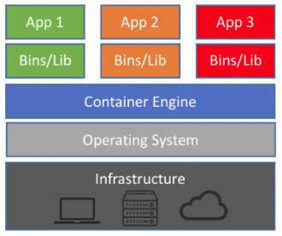
Containers
Next step in virtualization, started ~2013
In VMs, OS files are duplicated in each VM, may be wasteful
Containers share OS files, just store binary and library files separately that are needed by applications
Apps are not allowed to affect each other
Isolation may not be as good as with separate VMs
Apps need to be based on the same OS
Docker and Kubernetes are popular container systems
https://blog.netapp.com/blogs/containers-vs-vms/

